Slide 1
Control Technology Incorporated

Slide 2
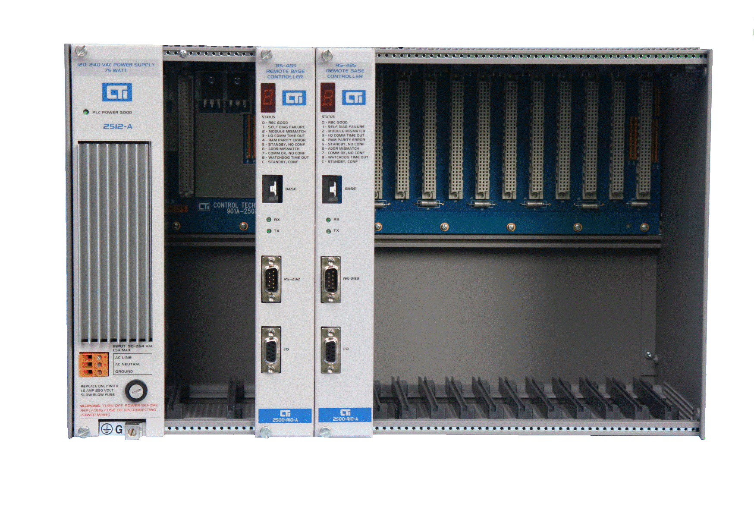
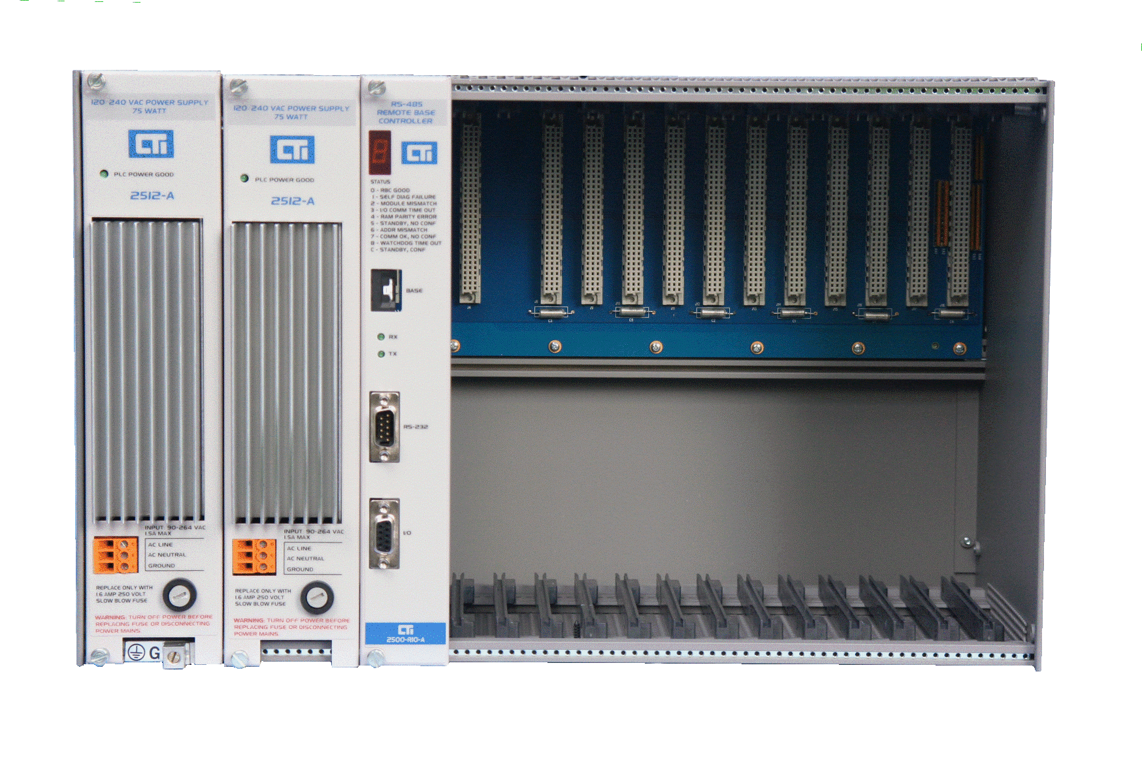
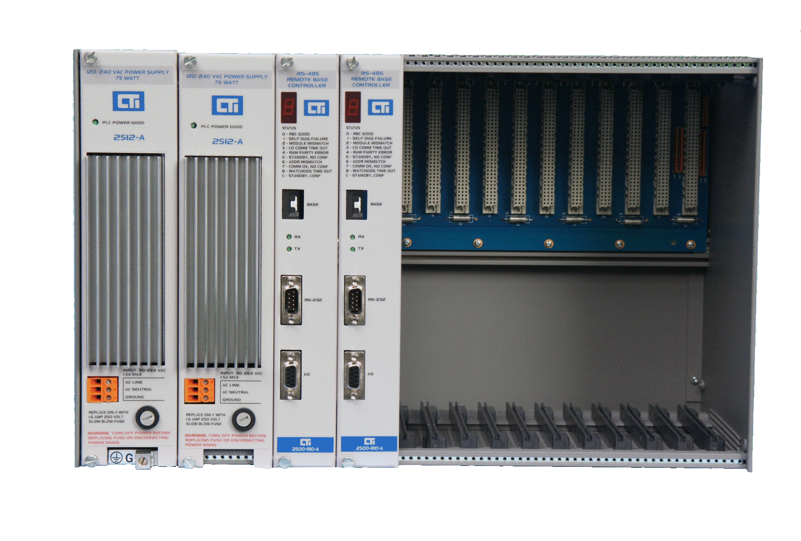
Product Spotlight Redundancy & Backup Solutions – Remote Bases
Redundant RBC
Redundant power
Redundant power & redundant RBCs

Slide 3
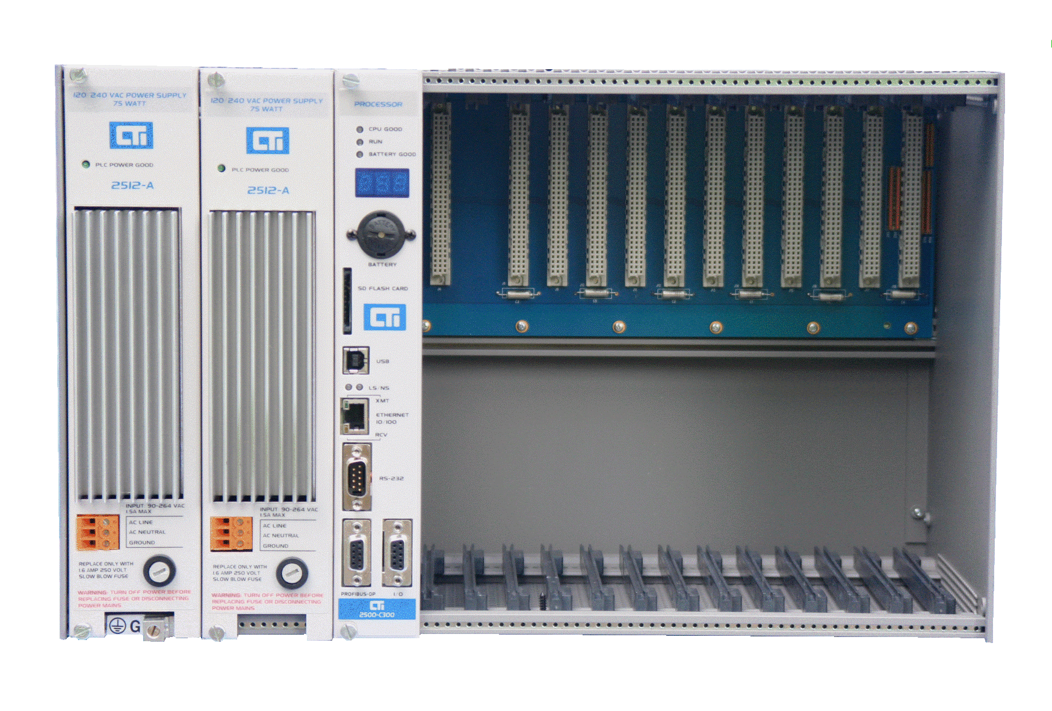
Product Spotlight Redundancy & Backup Solutions – Processors
Redundant power with one CPU

Slide 4
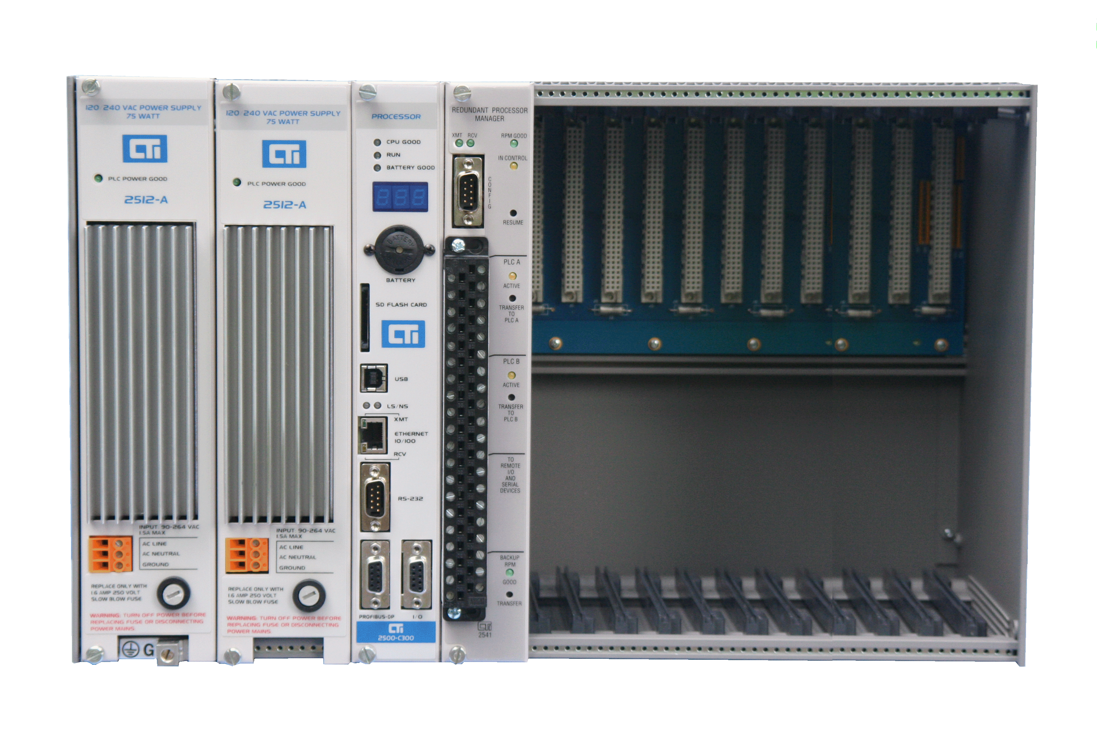
Product Spotlight Redundancy & Backup Solutions – Processors
Redundant power & redundant CPUs using Redundant Processor Manager
To remote bases

Slide 5
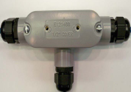
Backup CPU with Redundant RBCs Using independent cables to RBCs
primary
termination
backup

Slide 6
Using the 2541 Redundant Processor Manager

Slide 7
2541 Redundant Processor Manager
“Warm” Backup for Simatic TI505 PLCs
Asynchronous program execution between two CPUs
Both CPUs see all the I/O
Transfer within 100ms or 2 scans
“Bumpless” transfer
Transfer of control without changing the outputs

Slide 8
How Does the RPM Work?
Communicates with both PLCs using the remote I/O connection
I/O is attached to the PLC in control using relay contacts
Both PLCs see the field inputs all the time
Monitors both PLCs and switches the I/O to the backup PLC in case of fault
Creates “virtual bases” that appear in both PLCs
Both PLCs and RPM can monitor all status information
Critical data is written to the backup PLC

Slide 9
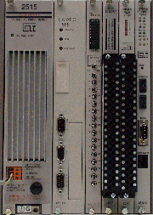
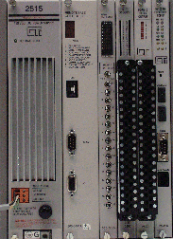
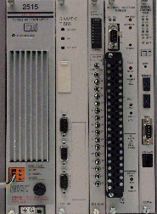
Configuration Example 1
PLC A
RPM Installed in rack with PLC B
Uses backplane for power only
Both PLCs are connected to the RPM module
Remote I/O is connected to the RPM module
I/O
PLC B

Slide 10
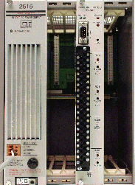
Configuration Example 2
PLC A
RPM installed in separate rack
Uses backplane for power only
Both PLCs are connected to the RPM module
Remote I/O is connected to the RPM module
RPM
PLC B
I/O

Slide 11
MMI Connection Example
PLC A
MMI
I/O
PLC B

Slide 12
RPM Front Panel
Module Status and Configuration Section
Serial Port, Status LEDs, Resume Button
PLC A Section
Connectors, Status LED, Transfer Button
PLC B Section
Connectors, Status LED, Transfer Button
Remote I/O and HMI Connectors

Slide 13
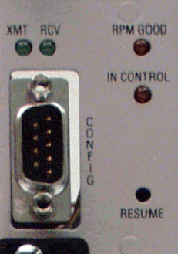
RPM Front Panel (top)
MODULE GOOD LED
When ON, the module is functioning properly
MODULE IN CONTROL LED
When ON, this module is controlling the switching
CONFIGURATION PORT
Configuration Port with signal LEDs
RESUME SWITCH
Press to resume operation after a module fault

Slide 14
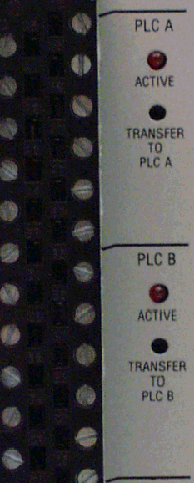
RPM Front Panel (mid)
PLC A ACTIVE LED
ON solid when PLC A is PLC in control
Blinking when PLC A is available for transfer
TRANSFER TO PLC A Switch
Request switchover to PLC A
PLC B ACTIVE LED
ON solid when PLC B is PLC in control
Blinking when PLC B is available for transfer
TRANSFER TO PLC B Switch
Request switchover to PLC B

Slide 15
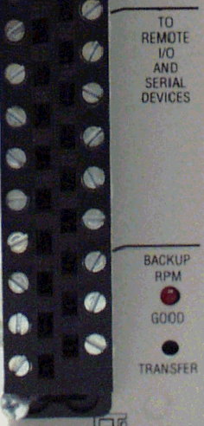
RPM Front Panel (lower)
Remote I/O and HMI Connectors
Reserved for Backup RPM
Not yet implemented

Slide 16
RPM Internal Diagram
Directly connects I/O to the active PLC through a relay contact
Monitors active and standby PLC
Sends input values to standby PLC
Sends virtual base data to standby PLC
Switches to standby PLC when a specified event occurs
RPM MODULE
Mirror Memory for I/O and (virtual bases)
PLC A
PLC B
Remote I/O

Slide 17
Transfer Conditions
Automatic transfer
Active PLC I/O update not received within a specified time
Active PLC “Heartbeat” not received within a specified time
RPM detects a fatal error in Active PLC
Manual transfer
PLC logic requests a transfer of control
Module pushbutton requests a transfer of control
Will not transfer if
Standby PLC is not operational (ie fatal error or no I/O scan)
Standby PLC program does not match Active (optional)
Disabled by user in configuration program

Slide 18
Module Fail-Safe Operation
Fail Safe mode activated when there is an RPM problem
Conditions to activate fail-safe
Loss of power to RPM
Early Power Fail is detected
RPM diagnostics detect an error
Watchdog timer trip
Action for fail-safe
Module defaults to a predetermined relay state
Hardware Controlled
Set by a switch on the board
Remote racks are connected to the predetermined PLC
If triggered by watchdog timer, the module remains in this state until user intervenes

Slide 19
Other RPM Functions
MMI Switching
Includes serial operator panels, TCAMs, etc.
Transfer follows the remote I/O switchover
PLC Data Transfer
Copies data from the Active PLC to the Standby PLC
Values that are required to prevent program divergence
Values that can’t be obtained via I/O image register
May include timers counters, drums, loops, etc.
Critical Data - Transfer Every Scan
Normal Data - Transfer over several Scans

Slide 20
Critical Data Transfer & Control
RPM creates “Virtual Bases” which appear to both PLCs
Up to 16 32WX/32WY modules
Data Transfer
Active PLC logic writes to virtual base WY’s
RPM copies WY value to a corresponding WX value
Standby PLC logic reads from virtual base WX’s
Logic must be conditioned on “Active” bit from RPM
Shows as a 1 for active PLC
Shows as a 0 for standby PLC

Slide 21
Creating Virtual Bases for Critical Data Transfer
Created using the 2541 configuration program
A virtual base appears in both PLCs
Looks just like a real base
Can be assigned any address not in use by a real base
You must create at least one virtual base (home base)
Used to transfer status bits for the RPM system to both PLCs
Contains up to 16 virtual modules
2 virtual discrete modules, one 32X, one 32Y
Can contain up to 14 virtual word modules (32WX, 32WY)
Additional virtual bases contain only virtual word modules
Logic is required in both PLCs and they must know whether they are in ‘active’ or ‘standby’

Slide 22
Non-critical Data Transfer
Configured in RPM module, no PLC logic required
Data Transfer
RPM reads from specified V memory block in active PLC
RPM writes to corresponding V memory block in standby PLC
Transfer takes multiple scans

Slide 23
RPM Status Bits (X values in home base)
Offset | Description
0 | PLC A has active control (1 = Yes, 0 = No)
1 | PLC B has active control (1 = Yes, 0 = No)
2 | PLC Active Flag (1 = this PLC is active, 0 = this PLC is standby)
3 | PLC A Status (1 = Operational, 0 = Not Operational)
4 | PLC B Status (1 = Operational, 0 = Not Operational)
5 | Checksum Compare (1 = Checksums match, 0 = Checksums do not match)
6-8 | Reserved
9 | Non-Critical Data Transfer Completed - Alternates with offset 10
10 | Non-Critical Data Transfer Completed - Alternates with offset 9
11 | RPM has control (reflects I/O update monitoring status, 1=enabled,0=disabled)
12 | Reserved for future use
13 | RPM module is good (operational)
14-15 | Reserved
16 | I/O Update Monitor Enable (1=Enabled, 0=disabled)
17 | Heartbeat Monitor (1=Enabled, 0=disabled)
18 | PLC Fatal Error Monitor (1=Enabled, 0=disabled)
19 | PLC Logic Transfer (1=Enabled, 0=disabled)
20 | Program Checksum Match (1=Enabled, 0=disabled)
21 | Front Panel Pushbutton Transfer (1=Enabled, 0=disabled)
22 | Switchover Enabled
23-31 | Reserved

Slide 24
RPM Control Bits (Y values in home base)
Offset | Description
0 | Request Switchover to PLC A
1 | Request switchover to PLC B
2 | Heartbeat bit. PLC Logic must transition this bit every scan
3 | Switchover Inhibit
4-31 | Reserved for future use

Slide 25
Setting up an RPM Application
Select wiring configuration and fail-safe operation
Identify critical and non-critical variables
Wire the system
Configure fail-safe and RTS on RPM
Configure the module using software
Setup switchover operation
Setup virtual bases and real bases
Add PLC logic to copy critical and non-critical data
Test

Slide 26
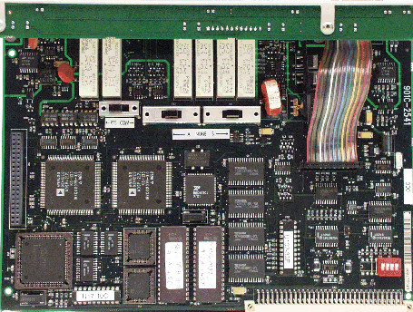
Setup of Fail-safe and RTS
Set RTS-COM switch to COM unless using RF converter
Set fail-safe switch for PLC A or PLC B

Slide 27
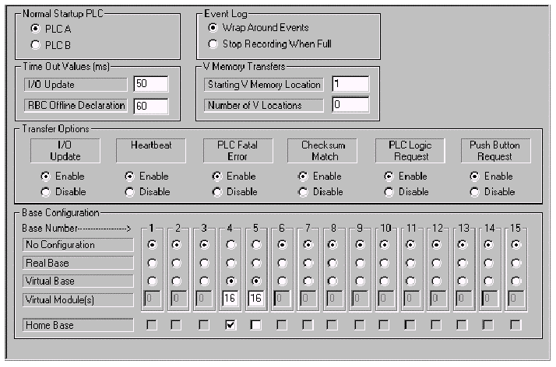
Software Configuration of the RPM
Install Windows configuration program
Attach to module using serial cable (TISOFT cable)
Run program and open port to 9600,odd, 7,1
Configure transfer options and bases
RPM Configuration

Slide 28
RPM Summary
Provides Warm Backup for TI505 PLCs
Automatically switches remote I/O and HMI
Provides data transfer between PLCs
Directly connects active PLC with remote I/O
No intervening electronics
Fail-safe default selection (hardware)
Software configurable options
Specify switchover options
Establish virtual bases and non critical data transfer

